Slide 1
iGEM Bee Gut Microbiome Report

Slide 2
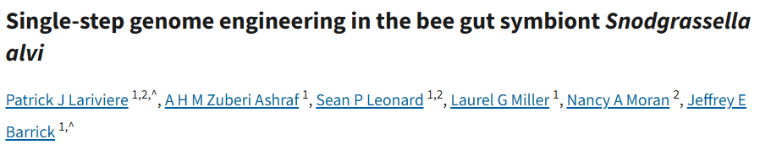
How do we insert genes into S.alvi?
doi/10.1128/mbio.01392-24

Slide 3
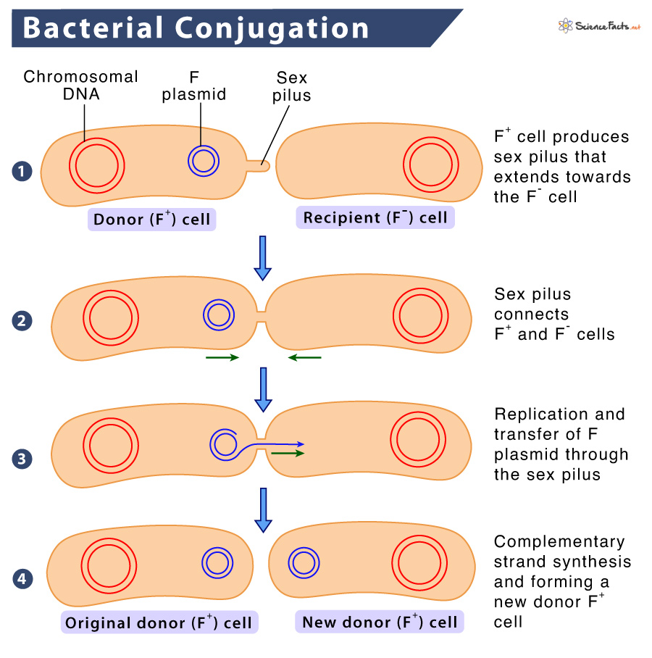
Limitation until now
[Previous method]
old homologous recombination approach
S. alvi does not naturally uptake DNA very well. Therefore, in the past, conjugation was used.
Conjugation is a method where a "donor" bacterium directly transfers a plasmid to a "recipient" bacterium.
However, conjugation is slow, can easily lead to insertion at incorrect locations, and requires repeated selection and screening steps to isolate the correct mutants.
Additionally, complex systems like Cas9 had to be used.

Slide 4
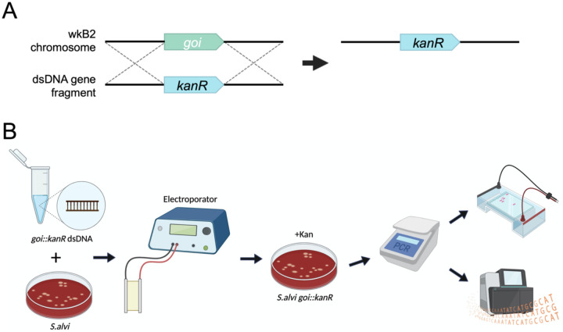
New method
[SnODIFY]
new homologous recombination approach
SnODIFY uses electroporation to directly deliver DNA into cells.
→DNA can be introduced without the need for conjugation.
The introduced DNA is then integrated into the chromosome through S. alvi’s native RecA-mediated homologous recombination.
Without the need for additional systems like Cas9, gene deletion (or insertion) can be achieved quickly and accurately in a single step.

Slide 5
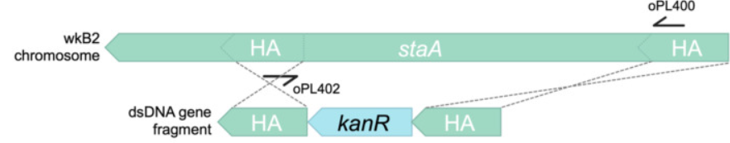
Gene that can be deleted(1)
staA – deletion with dsDNA
This gene is non-essential and was previously deleted using the Cas9/suicide vector approach. Designed kanR knockout constructs with homology arms of either 500 bp or 1000 bp within the staA gene. Initial electroporations using approximately 150 ng and 300 ng of DNA did not yield any transformants. When the DNA concentration was increased to 5 μg, were able to successfully obtain kanamycin-resistant transformants. Found that using 1000 bp homology arms resulted in 85 transformants, whereas no transformants were obtained when using 500 bp homology arms.

Slide 6
How reliable is SnODIFY?
SnODIFY enables reliable gene knockout - Gene that can be deleted(2)
Knockout constructs targeting six additional non-essential S. alvi genes (pilF, pilG, asr, asmE, recJ, and recA) were designed and tested. Among the six target genes, five showed 100% editing accuracy based on PCR or WGS results, while one gene (asr) showed 50% editing accuracy. (Notably, inconclusive PCR screening for asr, indicated by the presence of two bands, suggests that the actual editing accuracy may be higher.)
Type IV pilus mutants generated using SnODIFY show impaired biofilm formation
Biofilm formation is a commonly used phenotype for validating new genome engineering tools. Using SnODIFY to knock out type IV pilus genes (pilF and pilG), a significant and visually noticeable decrease in biofilm formation was observed compared to the wild-type strain.

Slide 7
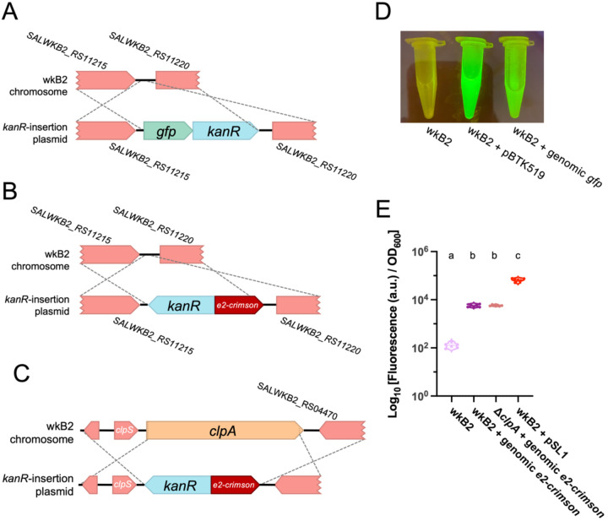
Gene insertion using SnODIFY
Insertion of heterologous genes is possible using circular plasmid DNA.
Attempted to insert fluorescent protein genes into the S. alvi chromosome by electroporating non-replicating E. coli plasmids. By leveraging recombination using plasmid DNA, knockout cassettes were constructed in the form of part plasmids according to the Bee Microbiome Toolkit (BTK) assembly scheme (details on BTK).
This strategy enables the re-use of homology flanks to easily integrate various payloads into the genome.
An intergenic region of the wkB2 genome, located between the non-essential genes SALWKB2_RS11215 and SALWKB2_RS11220, was selected as the insertion site. Designed part plasmids containing a gene encoding one of two fluorescent proteins (GFP or E2-Crimson) along with an antibiotic resistance gene. Homology arm plasmids were also prepared separately.
The parts were assembled into a single plasmid using Golden Gate cloning in E. coli, and the assembled plasmid was introduced into S. alvi via electroporation.

Slide 8
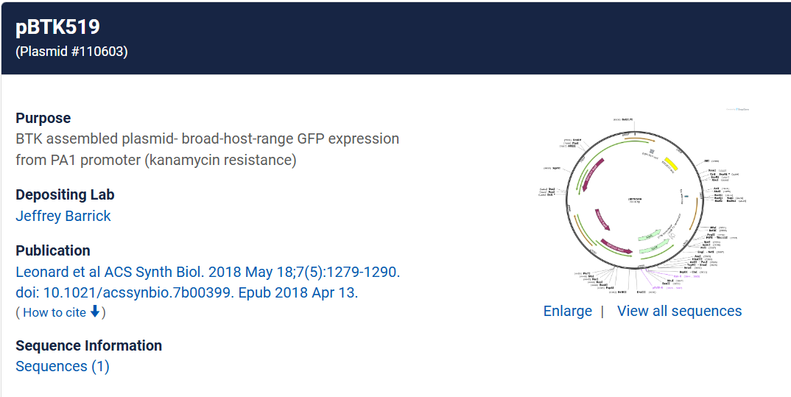
Results
Image of wkB2, wkB2 + pBTK519 (positive control), and wkB2 + genomic gfp cells in front of a blue light transilluminator (470 nm), demonstrating successful insertion of gfp as evidenced by green fluorescence that is not observed in WT cells.
Plot of quantification of e2-crimson fluorescence, demonstrating that wkB2 + genomic e2crimson cell pellets resuspended in PBS display significantly increased red fluorescence compared to wkB2, and only slightly less fluorescence than wkB2 + pSL1, which contains a multicopy plasmid expressing e2-crimson. Log₁₀ of OD_{611 ex, 646 em}/OD₆₀₀ is shown for cell cultures that were pelleted, resuspended in PBS, and read in a 96 well plate.

Slide 9
Why use plasmids when dsDNA could be used?
[Efficiency and stability aspects]
[Convenience and modularity aspects]
Using plasmids offers:
Modular assembly, similar to the BTK (Bee Microbiome Toolkit)
Fluorescent genes, antibiotic markers, and homology arms can be easily swapped and reassembled like building blocks.
Complex constructs can be rapidly assembled using Golden Gate cloning.
Easier setup for repeated or varied experiments
No need to synthesize new dsDNA by PCR every time.
Simply amplify the plasmid in E. coli and purify it for use.
 | Linear dsDNA | Plasmid DNA
DNA Stability | Easily degraded (nuclease sensitive) | Stable (no free ends)
Recombination Efficiency | Low | Comparable or slightly higher
Experimental Reproducibility | Unstable (efficiency can vary between batches) | Stable cloning structure, advantageous for repeated experiments

Slide 10
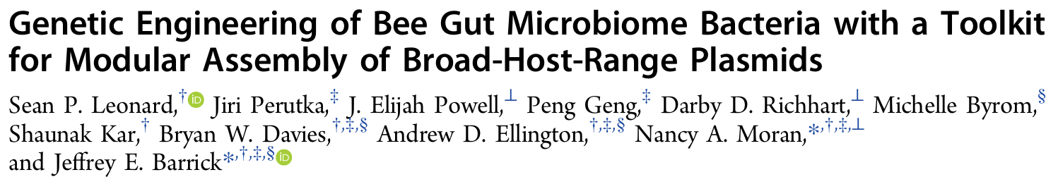
Vectors for S.alvi
DOI: 10.1021/acssynbio.7b00399

Slide 11
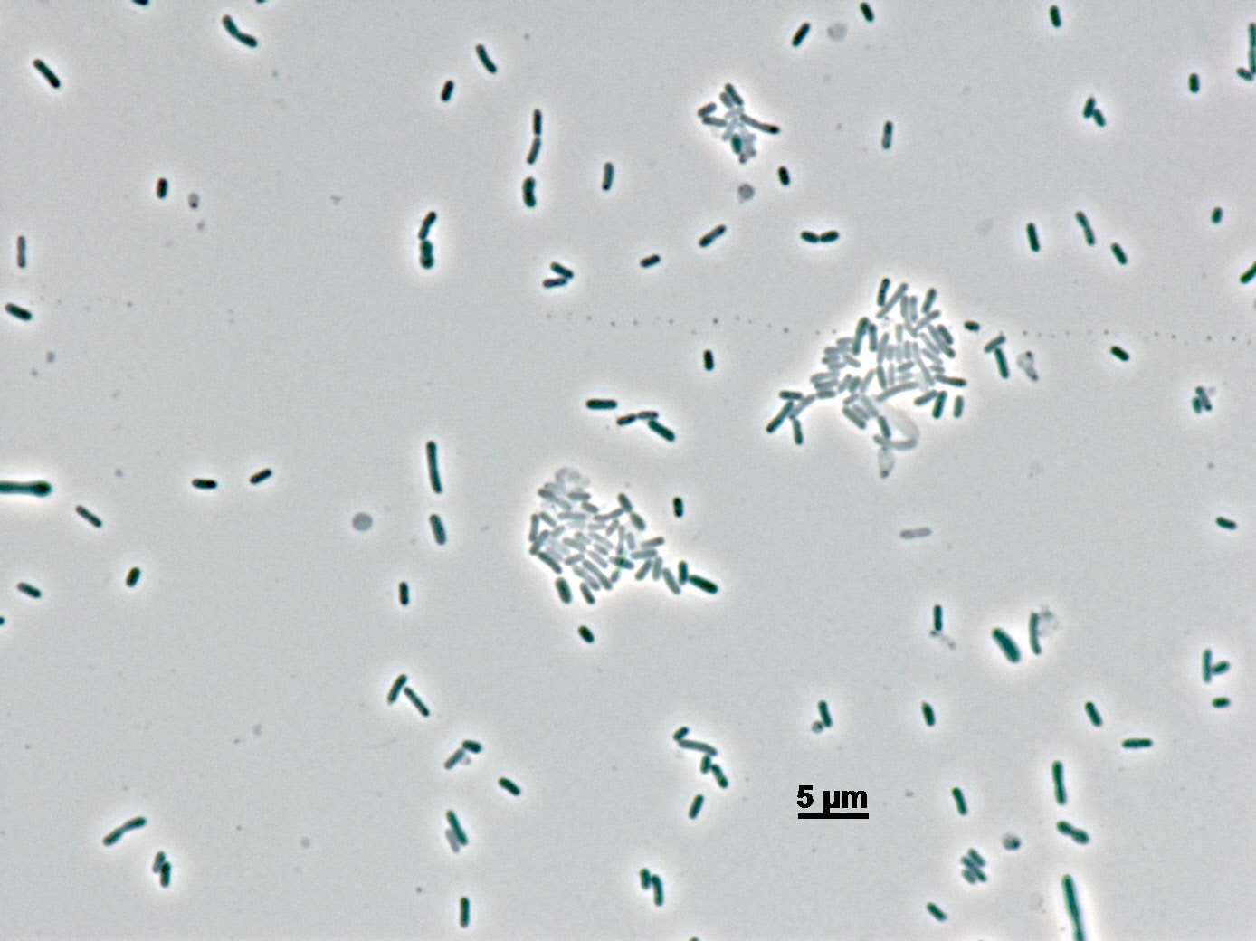
Limitation until now
One approach to genetically modifying a microbiome is to introduce genetically engineered versions of platform organisms. However, even model bacteria that perform reliably under laboratory conditions often fail to survive, proliferate, or persist when introduced into natural microbial communities.
A promising alternative is to engineer bacteria that naturally inhabit these environments. However, aside from random transposon mutagenesis in S. alvi, no genetic tools have been reported for these species.

Slide 12
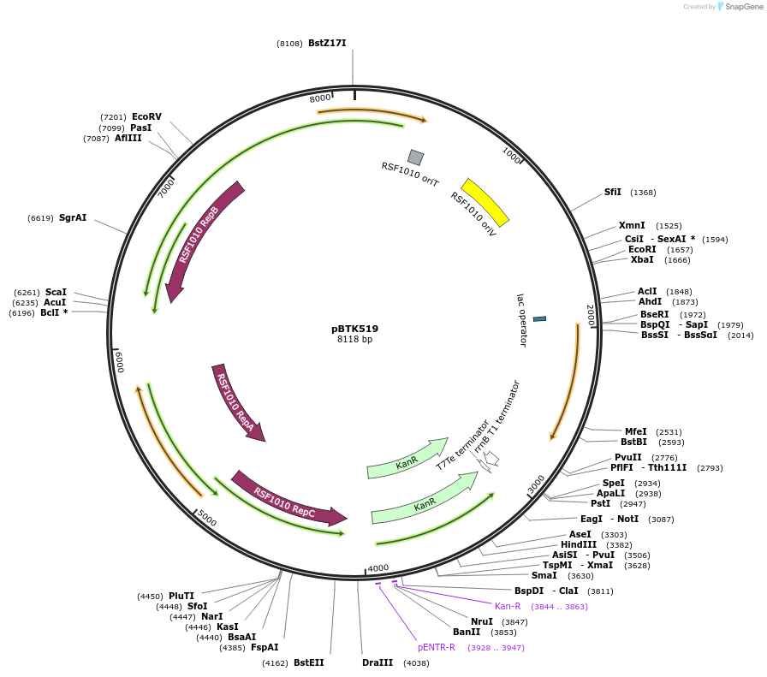
BTK
A plasmid toolkit that combines a broad-host-range (BHR) replicon with a modular set of genetic parts.
Plasmids constructed using this Bee Microbiome Toolkit (BTK) function stably across multiple species of Proteobacteria found in the Bee Gut Microbiome, including S.alvi.
BTK can be used to express heterologous genes from bacterial chromosomes or to repress or disrupt native genes.

Slide 13
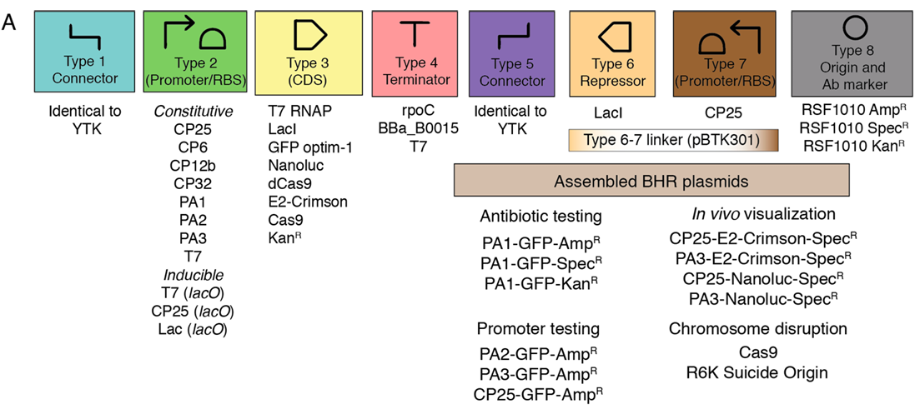
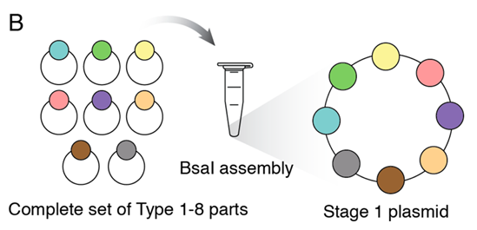
Design of the Bee Microbiome Toolkit (BTK)
The parts in BTK are compatible with the Golden Gate cloning method used in the Yeast Toolkit (YTK) and require connector parts from YTK for assembly. BTK parts are categorized into eight types based on the specific overhangs generated by type IIS restriction enzymes. By assembling a complete set of parts numbered 1 through 8, a final plasmid can be constructed in a single BsaI Golden Gate reaction.
The BTK is designed based on a plasmid containing the RSF1010 origin, which is known for its extremely broad host range. BTK provides a genetic parts toolkit that enables hierarchical and combinatorial assembly of modular genetic elements on an RSF1010-derived backbone.

Slide 14
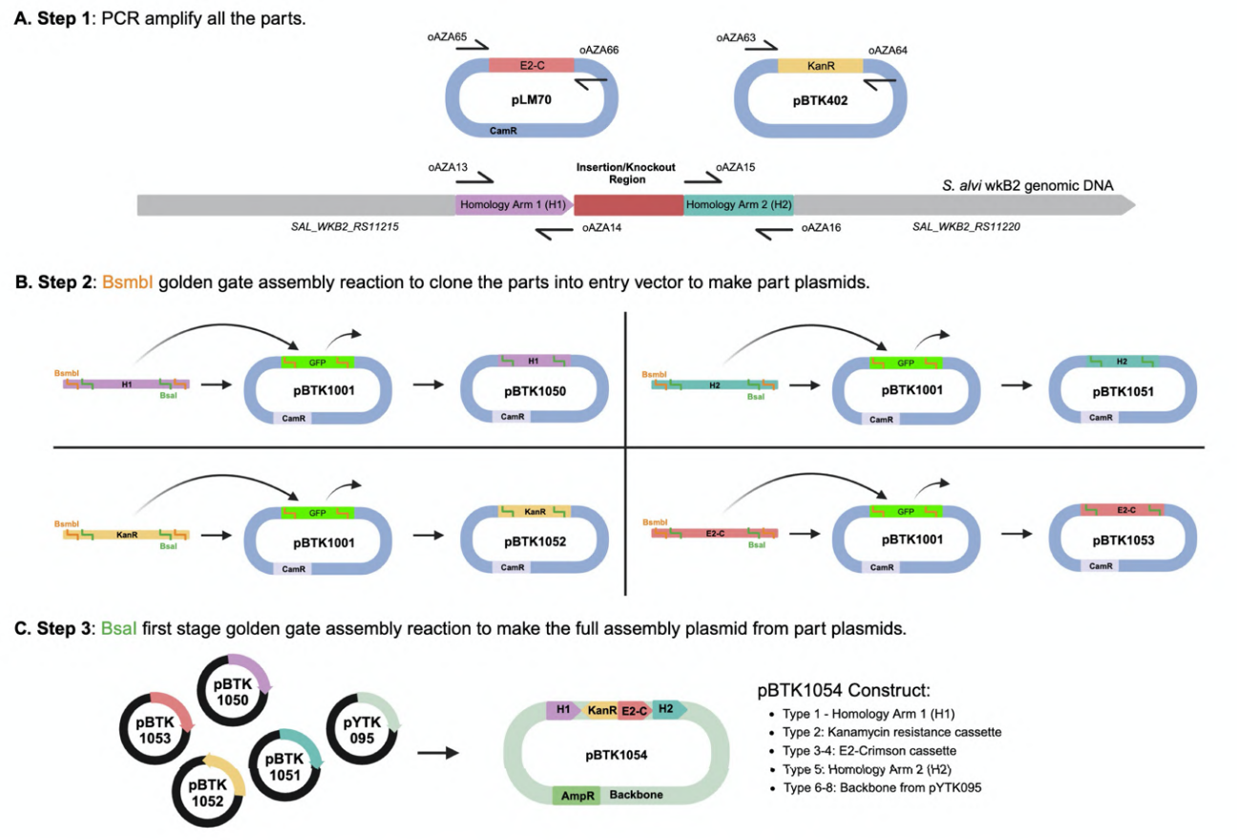
Golden Gate cloning?
[e2-crimson genomic insertion plasmid assembly diagram]
A. Plasmid and genome maps depicting regions that were used as templates for insert construction. e2-crimson (from pLM70), kanR (from pBTK402), and homology arms flanking the insertion site (from S. alvi genomic DNA) were amplified via PCR. Primers used to amplify these parts contain BsmbI and BsaI recognition and cut sites.
B. Plasmid maps depicting assembly of part plasmids. Parts were cloned into entry vectors (pBTK1001) using BsmbI Golden Gate Assembly mix (NEB, USA) to make part plasmids containing homology arms, e2-crimson, and kanR.
C. Plasmid maps depicting final assembly of the part plasmids (Type 1-8) using BsaI first-stage Golden Gate Assembly mix (NEB, USA) to create the e2-crimson genomic insertion plasmid .

Slide 15
How this works
If you want to assemble three DNA fragments, A → B → C, into a single plasmid, it would be difficult to manually connect them in the correct order. However, Golden Gate cloning allows automatic assembly in the predetermined order. At both ends of each fragment, the overhangs that will be generated after cutting with a type IIS restriction enzyme are pre-designed.
Example:
The overhangs act as adhesive sequences that allow DNA fragments to join. The right end of A and the left end of B share the same overhang sequence (TTGC), and the right end of B and the left end of C also match with the sequence CTGA, enabling proper assembly.
Fragment | Left overhang | Right overhang
A | GGAA | TTGC
B | TTGC | CTGA
C | CTGA | AGCT

Slide 16
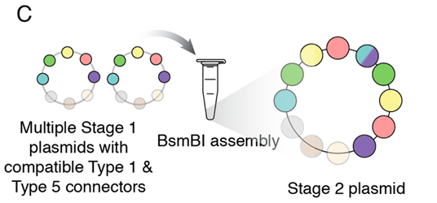
Stage 2 plasmid
Through this assembly, a Stage 1 plasmid is generated, where parts 2 to 4 form the central region, connector parts 1 and 5 are positioned at each end, and parts 6 to 8 comprise the plasmid backbone elements. When the sets of connector parts between Stage 1 plasmids match, Stage 2 assembly using BsmBI can be performed to combine multiple transcriptional units into a single vector.

Slide 17
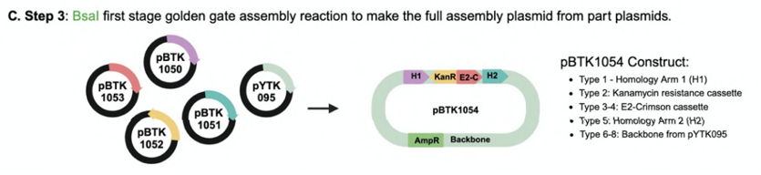
Components of the BTK
3 BHR plasmids with different antibiotic resistance cassettes and oriT as Type 8 origin parts for Stage 1 assembly
11 bacterial promoter/RBS combinations as Type 2 parts
8 new CDSs including E2-Crimson39 and Nanoluc40 for in vivo visualization as Type 3 parts
3 bacterial terminators as Type 4 parts
2 R6K-origin plasmid backbones to assemble suicide plasmids for gene disruption or chromosomal modification
2 BHR plasmids ready for Stage 2 assembly (SpecR, KanR)
1transcriptional repressor (LacI) as a Type 6 part
Preassembled plasmids with BHR promoters for immediate testing in new bacterial strains *
necessary
*: not necessary for this iGEM project

Slide 18
Summary of BTK parts, assembled BTK plasmids, and their validation results (t1-t3)
Supplemental Dataset SD1. Bee Microbiome Toolkit (BTK) parts
part | type | 5'-site | 3'-site | description | marker | origin | Part Source | S. alvi
Entry Vector
pBTK001 | entry vector |  |  | entry vector for generating new parts | CamR | p15A | 1
pYTK001 from Yeast Toolkit is a suitable entry vector
Type 1 - Connectors
Use Connector sequences from Yeast Toolkit
Type 2 - Promoters
Constitutive
pBTK102 | promoter | 2 | 2 | T7 + RBS | CamR | ColE1 | 2
pBTK107 | promoter | 2 | 2 | CP25 + RBS | CamR | ColE1 | 3
pBTK110 | promoter | 2 | 2 | CP6 + RBS | CamR | ColE1 | 3
pBTK112 | promoter | 2 | 2 | CP12b + RBS | CamR | ColE1 | 3
pBTK113 | promoter | 2 | 2 | CP32 + RBS | CamR | ColE1 | 3
pBTK119 | promoter | 2 | 2 | PA1 + RBS | CamR | p15A | 4
pBTK120 | promoter | 2 | 2 | PA2 + RBS | CamR | p15A | 4
pBTK121 | promoter | 2 | 2 | PA3 + RBS | CamR | p15A | 4
Inducible
pBTK103 | promoter | 2 | 2 | Lac lacO + RBS | CamR | ColE1 | 6
pBTK124 | promoter | 2 | 2 | CP25 (lacO) | CamR | ColE1
pBTK130 | promoter | 2 | 2 | T7 (lacO) | CamR | ColE1
Type 3 - Coding Sequences
pBTK200 | coding_sequence | 3 | 3 | T7 RNA Polymerase | CamR | ColE1 | 2
pBTK203 | coding_sequence | 3 | 3 | LacI repressor | CamR | ColE1 | 6
pBTK205 | coding_sequence | 3 | 3 | GFP optim-1 | CamR | ColE1 | 7
pBTK206 | coding_sequence | 3 | 3 | Nanoluc | CamR | ColE1 | 8
pBTK209 | coding_sequence | 3 | 3 | dCas9 | CamR | ColE1 | 9
pBTK224 | coding_sequence | 3 | 3 | E2-Crimson | CamR | ColE1 | 10
pBTK229 | For homologous recombination | 3 | 3 | Kanamycin Resistance | CamR | ColE1 | 1
*expression was strong in S.alvi
*expression was strong in S.alvi
 | Untested
 | Tested, functions as expected
 | Tested, partial function
 | Tested, non-functional

Slide 19
Summary of BTK parts, assembled BTK plasmids, and their validation results (t4-t8)
Type 4 - Terminators
pBTK300 | terminator | 4 | 4 | rpoC | CamR | ColE1 | 11
pBTK301 | terminator | 6 | 7 | BBa_B0015 Terminator | CamR | ColE1 | 12
pBTK305 | terminator | 4 | 4 | T7 | CamR | ColE1 | 2
Type 5 - Connectors
Use Connector sequences from Yeast Toolkit
Type 6 - Repressors (reverse CDS)
pBTK211 |  | 6 | 6 | LacI Reverse | CamR | ColE1 | 13
Type VII - Reverse promoters
pBTK138 | promoter | 7 | 7 | CP25 + RBS Reverse | CamR | ColE1 | 3
Type 8 - Origins and Antibiotics
pBTK401 | origin_marker | 8 | 8 | mRFP1 dropout | AmpR | RSF1010 | 14
pBTK402 | origin_marker | 8 | 8 | mRFP1 dropout | KanR | RSF1010 | 14
pBTK403 | origin_marker | 8 | 8 | mRFP1 dropout | SpecR | RSF1010 | 14
 | Untested
 | Tested, functions as expected
 | Tested, partial function
 | Tested, non-functional

Slide 20
Vector Building
With Benchling(https://benchling.com)

Slide 21
Component Summary by Type
Type | Element Name | Note
Entry Vector 1 | H1 (Upstream Homology Arm) | pBTK1050
Entry Vector 2 | Promoter + RBS | pBTK107
Entry Vector 3 | Opd gene | Should assemble by golden gate
Entry Vector 4 | Terminator | Should assemble by golden gate
Entry Vector 5 | H2 (Downstream Homology Arm) | pBTK1051
Backbone | pYTK095 or equivalent | BsaI restriction enzyme

Slide 22
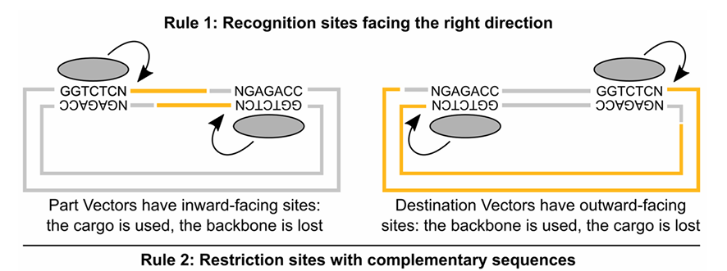
Important rule to follow

Slide 23
Graphic
pYTK095
c | c | c | t | t | g | a | g | a | c | c |  | g | g | t | c | t | c | a | t | a | c | a
g | g | g | a | a | c | t | c | t | g | g |  | c | c | a | g | a | g | t | a | t | g | t
H1 arm
g | g | t | c | t | c | a | c | c | c | t | 1 | a | a | c | g | t | g | a | g | a | c | c
c | c | a | g | a | g | t | g | g | g | a |  | t | t | g | c | a | c | t | c | t | g | g
Promotor/RBS
g | g | t | c | t | c | a | a | a | c | g | 2 | t | a | t | g | t | g | a | g | a | c | c
c | c | a | g | a | g | t | t | t | g | c |  | a | t | a | c | a | c | t | c | t | g | g
CDS
g | g | t | c | t | c | N | t | a | t | g | 3 | g | g | a | t | N | g | a | g | a | c | c
c | c | a | g | a | g | N | a | t | a | c |  | c | c | t | a | N | c | t | c | t | g | g
terminator
g | g | t | c | t | c | N | g | g | a | t | 4 | g | c | t | g | N | g | a | g | a | c | c
c | c | a | g | a | g | N | c | c | t | a |  | c | g | a | c | N | c | t | c | t | g | g
H2 arm
g | g | t | c | t | c | a | g | c | t | g | 5 | t | a | c | a | t | g | a | g | a | c | c
c | c | a | g | a | g | t | c | g | a | c |  | a | t | g | t | a | c | t | c | t | g | g

Slide 24
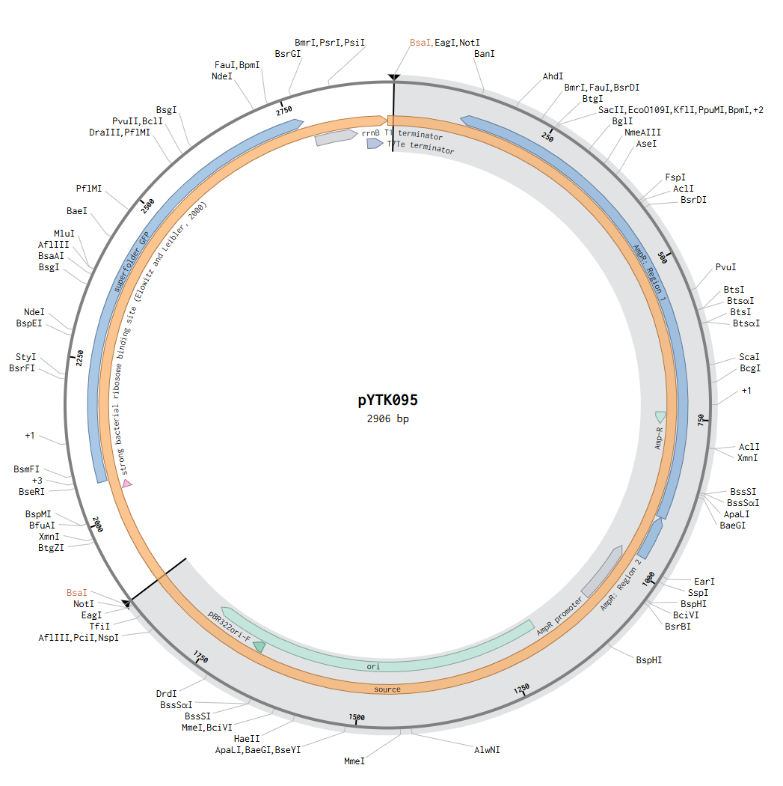
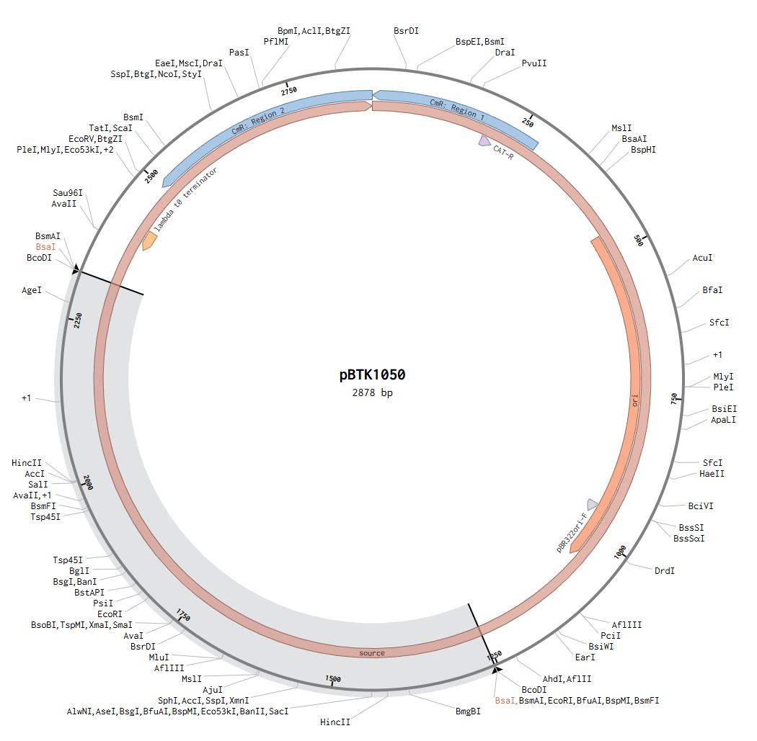
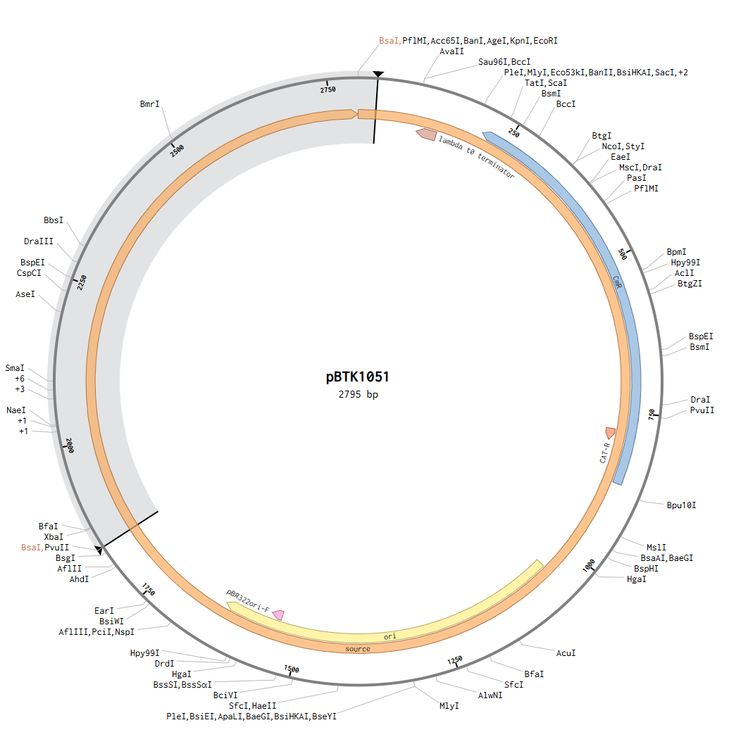
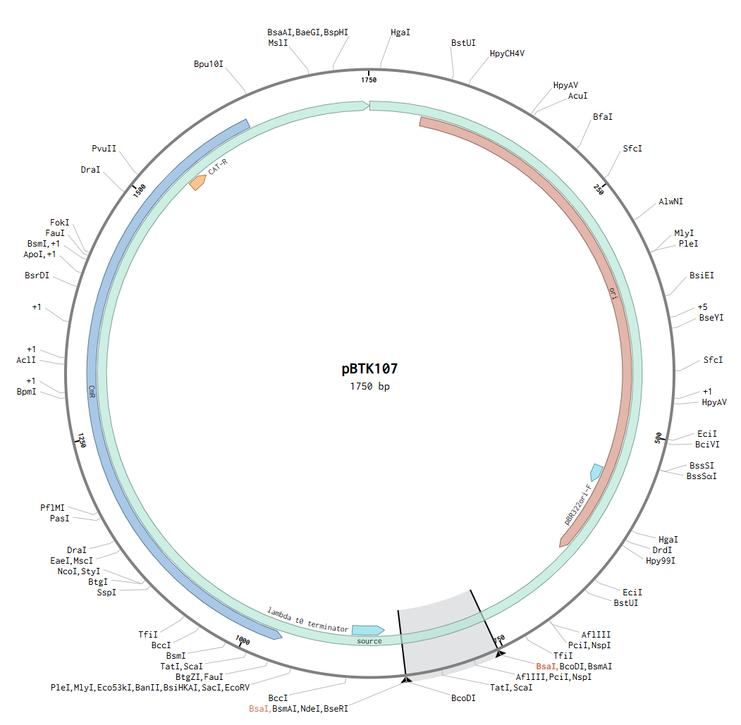
Result
c | c | c | t | 1 | a | a | c | g | 2 | t | a | t | g | 3 | g | g | a | t | 4 | g | c | t | g | 5 | t | a | c | a
g | g | g | a |  | t | t | g | c |  | a | t | a | c |  | c | c | t | a |  | c | g | a | c |  | a | t | g | t

Slide 25
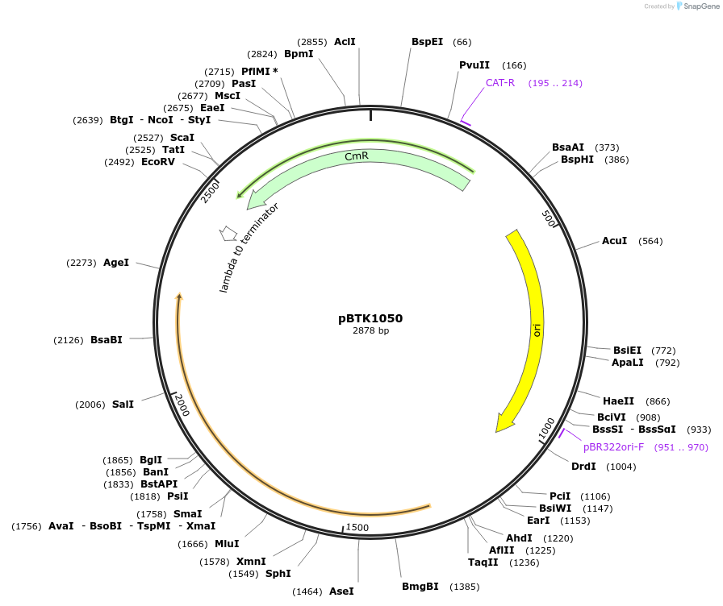
Vector Building - Entry Vector 1
Homology Arm1

Slide 26
Homology Arm 1
[pBTK1050]
pBTK1050 is a BTK (Bee Microbiome Toolkit) Type 1 entry plasmid designed for Golden Gate assembly, containing an upstream homology arm for targeted recombination into the Snodgrassella alvi wkB2 genome between the SALWKB2_RS11215 and SALWKB2_RS11220 intergenic region. The plasmid uses pBTK1001 as its backbone, confers chloramphenicol resistance, and replicates as a high-copy plasmid in E. coli DH5α. The inserted homology arm is approximately 1057 bp in size, and the plasmid utilizes BsmBI recognition sites for Golden Gate cloning, with the BsmBI sites destroyed during the assembly process. pBTK1050 serves as one of the key part vectors for final plasmid construction in genome engineering applications.

Slide 27
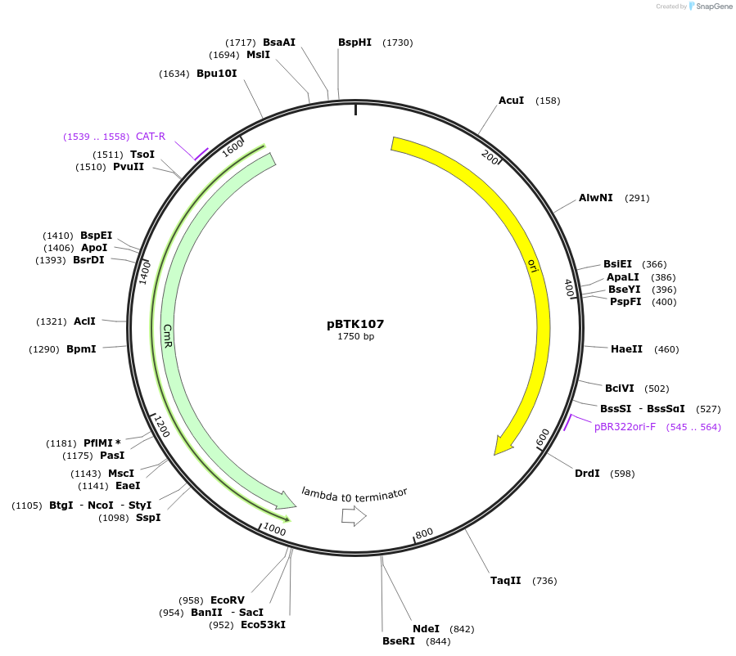
Vector Building - Entry Vector 2
Promotor/RBS

Slide 28
Promoter+RBS
[pBTK107]
The pBTK107 plasmid contains a CP25 constitutive promoter with an integrated ribosome binding site (RBS), designed for modular Golden Gate assembly. It features a ColE1 origin of replication and confers chloramphenicol resistance for bacterial selection. The CP25 promoter ensures continuous gene expression without the need for external induction, making it ideal for stable and consistent expression systems such as genome-integrated constructs in Snodgrassella alvi. As a verified part of the Bee Microbiome Toolkit (BTK), pBTK107 offers reliable performance for synthetic biology applications.

Slide 29
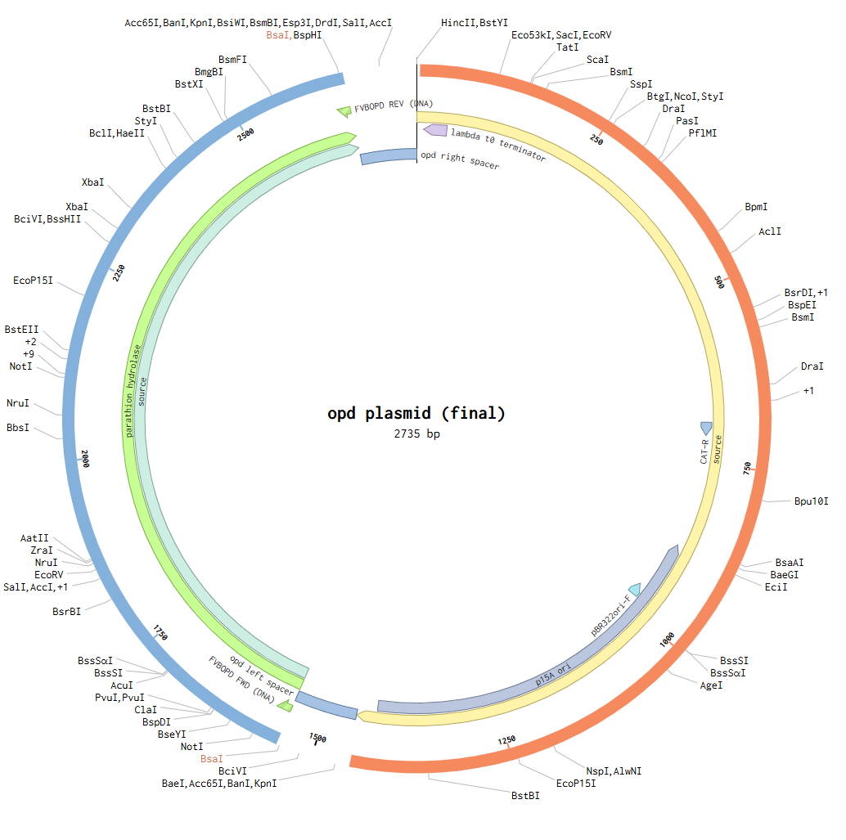
Vector Building - Entry Vector 3
CDS(opd)

Slide 30
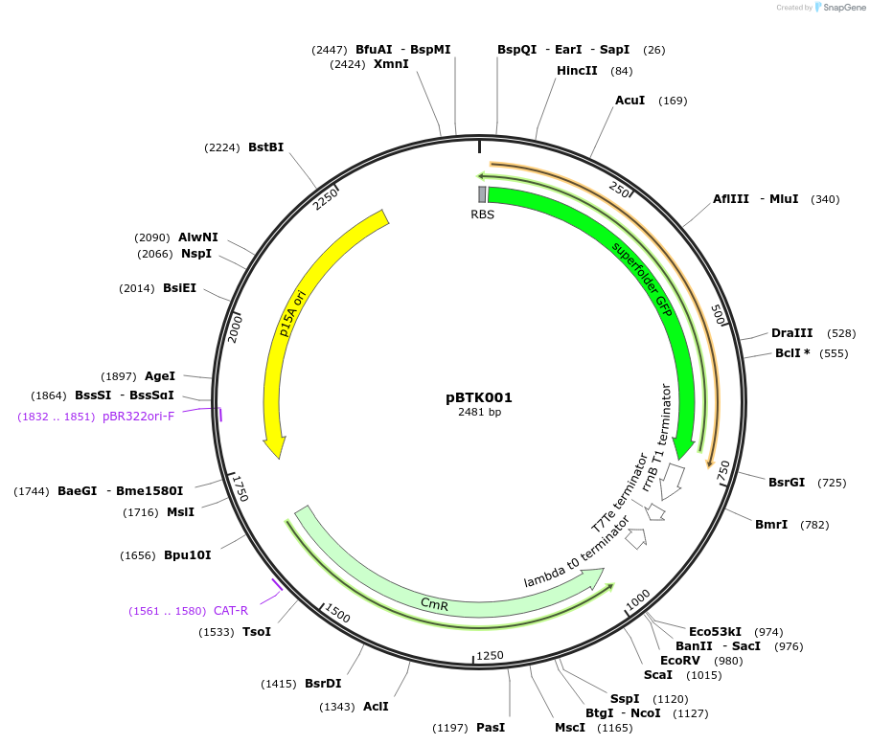
Entry vector backbone
[pBTK001]
pBTK001 is the base entry vector used in the Bee Microbiome Toolkit (BTK) system, designed as a broad-host-range backbone plasmid. It contains a superfolder GFP gene, allowing for easy verification of assembly and expression. The plasmid confers chloramphenicol resistance (12.5 µg/mL) and replicates as a low-copy plasmid in E. coli DH5α. It uses the P15A origin of replication and is primarily intended for applications in synthetic biology. pBTK001 serves as the starting point for Golden Gate assembly of entry parts, supporting a wide range of genetic combinations and recombination experiments.

Slide 31
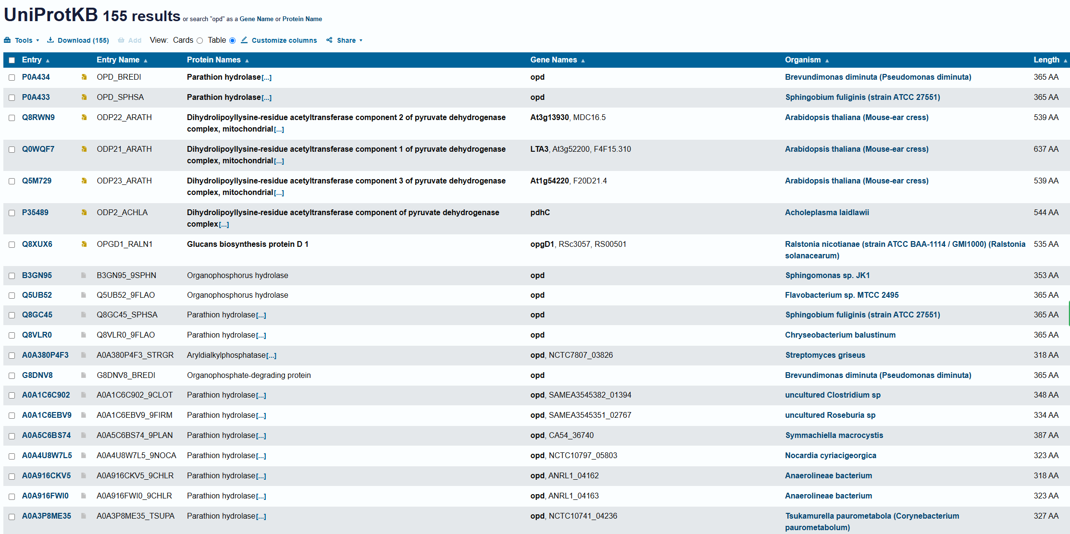
Gene of interest - opd
When searching for the opd gene in UniProt, many different genes appear. There are important criteria to consider when deciding which one to use. First, it must have actual Organophosphate Hydrolase (OPH) activity. Second, it must come from a well-characterized bacterial strain. The bacterial strains that meet these criteria are shown on the next slide.

Slide 32
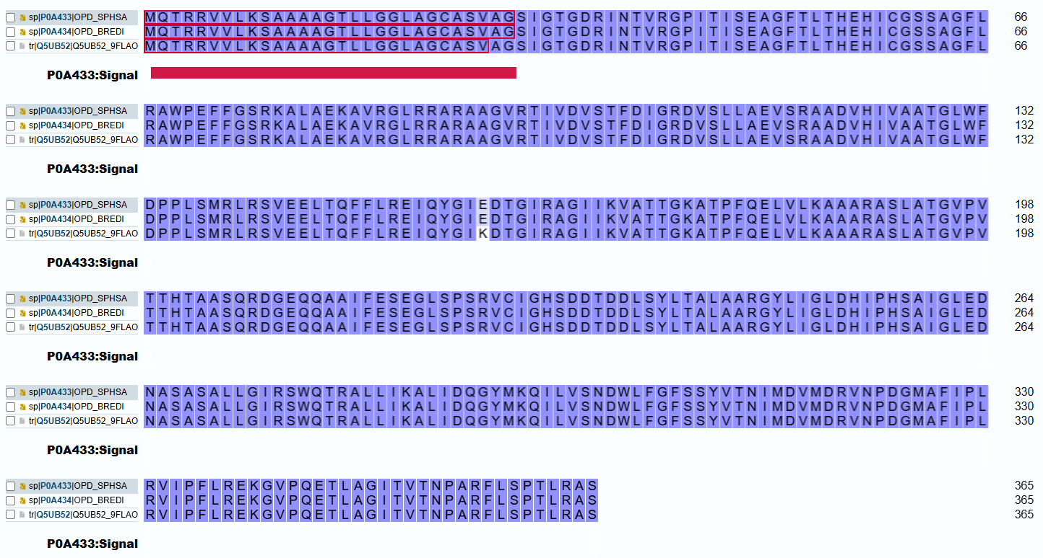
opd gene choosing
Entry | Protein Name | Organism | Length
P0A433 | Parathion hydrolase | Sphingobium fuliginis (strain ATCC 27551) | 365 AA
P0A434 | Parathion hydrolase | Brevundimonas diminuta (Pseudomonas diminuta) | 365 AA
Q5UB52 | Organophosphorus hydrolase | Flavobacterium sp. MTCC 2495 | 365 AA
Q8VLR0 | Parathion hydrolase | Chryseobacterium balustinum | 365 AA
When comparing the sequences of candidate opd genes, P0A433, P0A434, and Q5UB52 showed almost complete identity, with only a single amino acid difference between them (a lysine to glutamic acid substitution). This difference is unlikely to significantly impact enzyme activity, as it is not located within the catalytic core. Therefore, P0A434, derived from Brevundimonas diminuta, was selected.

Slide 33
Sequence(FASTA)
>M20392.1 Plasmid pCMS1 (from P.diminuta) phosphodiesterase (opd) gene, complete cds
CTGCAGCCTGACTCGGCACCAGTCGCTGCAAGCAGAGTCGTAAGCAATCGCAAGGGGGCAGCATGCAAAC
GAGAAGGGTTGTGCTCAAGTCTGCGGCCGCGAGAACTCTGCTCGGCGGCCTGGCTGGGTGCGCGACGTGG
CTGGATCGATCGGCACAGGCGATGCGATCAATACGTGCGCGTCCTATCACAATCTCTGAAGCGGGTTTCA
CACTGACTCACGAGGACATCTCGGCAGCTCGGCAGGATTCTTGCGTGCTTGGCCAGAGTTCTTCGGTAGC
GCAAAGCTCTAGCGGAAAAGGCTGTGAGAGGATTGCGCGCCAGAGCGGCTGGCGTGCGAACGATTGTCGA
TGTGTCGACTTTCGATATCGGTCGCGACGTCAGTTTATTGGCCGAGGTTTCGCGGGCTGCCGACGTTCAT
ATCTGGCGGCGACCGGCTTGTGGTTCGACCCGCCACTTTCGATGCGATTGAGGTATGTAGAGGAACTCAC
ACTAGTTCTTCCTGCGGTGAGATTCAATATGGCATCGAAGTACACCGGAATTAGGGCGGGCATTATCAAG
GTCGCGACCACAGGCAAGGCGACCCCCTTTCAGGAGTTAGTGTTAAAGGCGGCCGCCCGGGCCAGCTTGG
CCACCGGTGTTCCGGTAACCACTCACACGGCAGCAAGTCAGCGCGATGGTGAGCGAGGCAGGCCGCCATT
TTTGAGTCCGAAGCTTGAGCCCTCACGGGTTTGTATTGGTCACAGCGATGATACTGACGATTTGAGCTAT
CTCACCGCCCTGCTGCGCGGATACCTCATCGGTCTAGACCACATCCCGCACAGTGCGATTGGTCTAGAAG
ATAATGCGAGTGCATCACCGCTCCTGGGCATCCGTTCGTGGCAAACACGGGCTCTCTTGATCAAGGCGCT
CATCGACCAAGGCTACATGAAACAAATCCTCGTTTCGAATGACTGGCTGTTCGGGTTTTCGAGCTATGTC
ACCAACATCATGGACGTGATGGATCGCGTGAACCCCGACGGGATGGCCTTCATTCACTGAGAGTGATCCC
ATTCTACGAGAGAAGGGCGTCCCACAGGAAACGCTGGCAGGCATCACTGTGACTAACCCGGCGCGGTTCT
GTGTCACCGACTTGCCGTGCATGACGCCATCTGGATCCTTCCACGCAGCGGCCACTATTCCCCGTCAAGA
TACCGAACGATGAAGTCGCGCATCGATAGGCATCTTCAATGTGATCAGGGCTGCCACCTCCAAAGCCGGT
GGCCACCCCTGTCGATAGTCTTGAGGGACGGTAGCGACGACCGTGCTTTTCGTGAACTGCAG

Slide 34
How to insert dsDNA into plasmid backbone
BsmBI
BsmBI
opd
BsaI
BsaI
opd
BsaI
BsaI
BsmBI
BsmBI
gfp
camR
camR

Slide 35
What dsDNA should look like:
BsmBI rec site
BsaI rec site
BsaI rec site
BsmBI rec site
t | c | g | g
a | g | c | c
t | a | t | g
a | t | a | c
opd
g | g | a | t
c | c | t | a
g | a | c | c
c | t | g | g
spacer
spacer
*CDS(opd) shouldn’t include any BsmBI rec site or BsaI rec site: none found

Slide 36
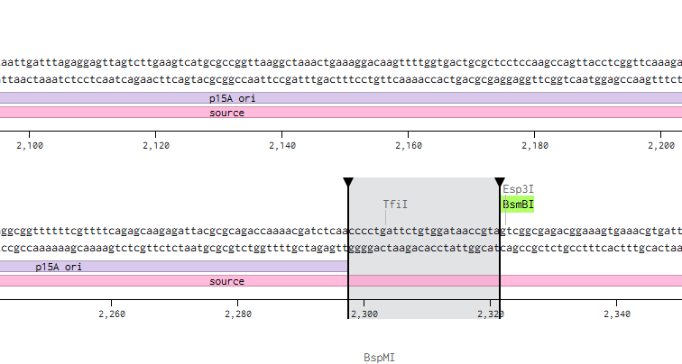
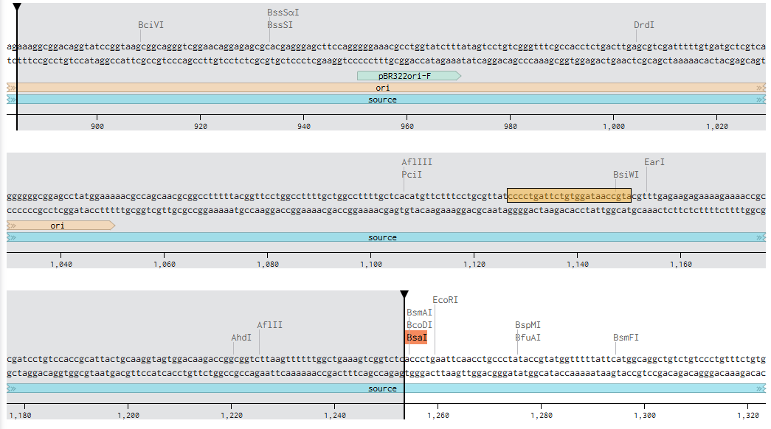
Check the spacer length: 104bp

Slide 37
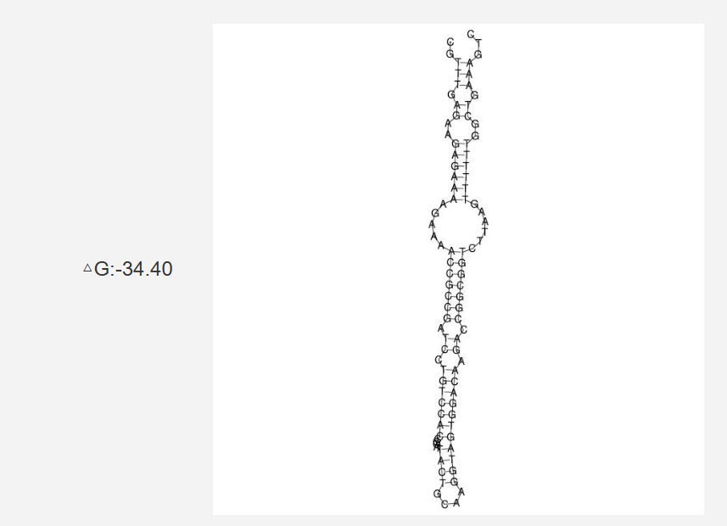
Spacer sequence should be…
Condition | Why
Maintain GC content between 40–60% | If it is too AT-rich or GC-rich, the structure can become either too unstable or too rigid.
Avoid hairpin structure formation | Hairpins (self-complementary binding within the sequence) can interfere with Golden Gate assembly or plasmid replication.
Avoid repeats/palindromic sequences | Too many repeats or palindromic sequences can increase plasmid instability.
Do not include strong promoter elements (-10/-35 boxes) | Accidental binding of RNA polymerase could lead to unintended transcription.
Do not include translation start codons (ATG) or ribosome binding sites (RBS) | Unwanted protein synthesis could occur from incorrect regions.

Slide 38
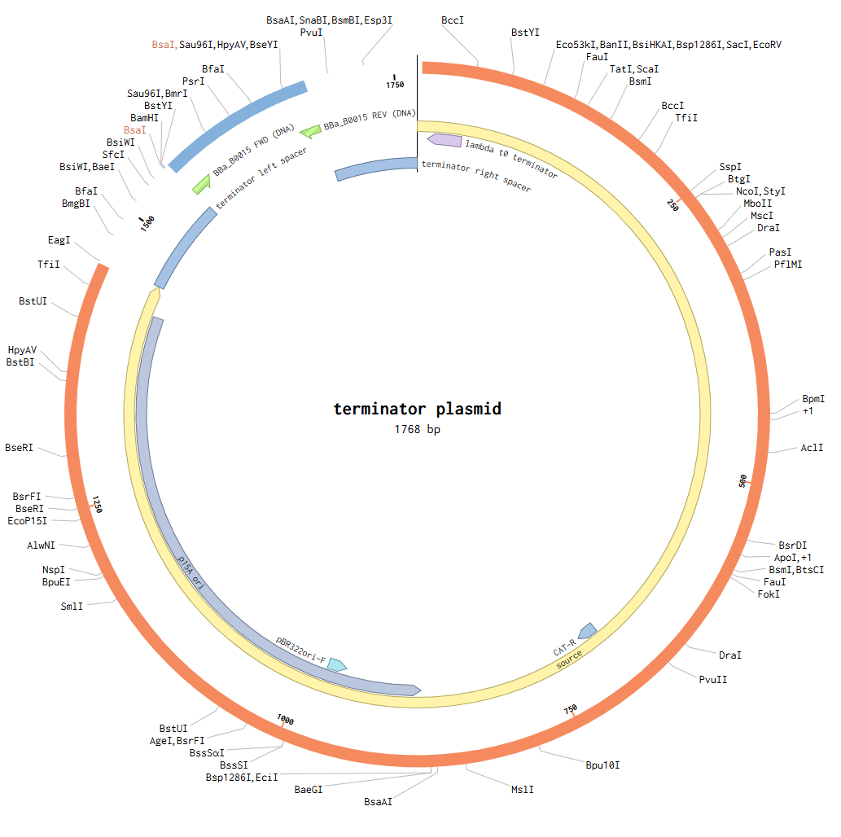
Vector Building - Entry Vector 4
Terminator

Slide 39
Entry vector backbone
[pBTK001]
pBTK001 is the base entry vector used in the Bee Microbiome Toolkit (BTK) system, designed as a broad-host-range backbone plasmid. It contains a superfolder GFP gene, allowing for easy verification of assembly and expression. The plasmid confers chloramphenicol resistance (12.5 µg/mL) and replicates as a low-copy plasmid in E. coli DH5α. It uses the P15A origin of replication and is primarily intended for applications in synthetic biology. pBTK001 serves as the starting point for Golden Gate assembly of entry parts, supporting a wide range of genetic combinations and recombination experiments.

Slide 40
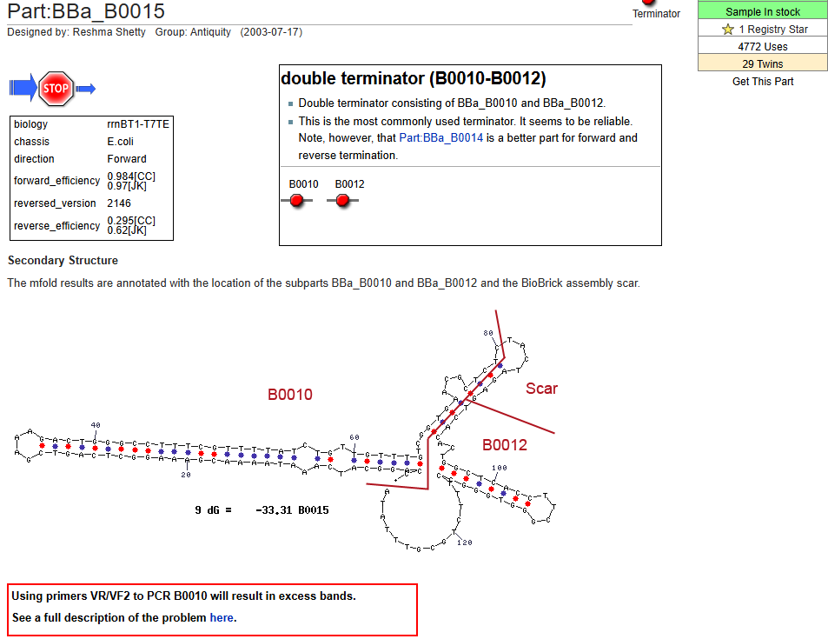
Sequence of interest - BBa_B0015
BBa_B0015 is a strong terminator widely used in the BioBrick Registry, a standardized parts library for synthetic biology. It is composed of two Rho-independent terminators, BBa_B0010 and BBa_B0012, arranged in tandem, resulting in highly efficient transcription termination. BBa_B0015 can be used with a variety of promoters and gene constructs and is particularly effective at preventing unwanted downstream transcription in plasmid-based expression systems. It has been validated to function strongly and reliably in bacteria, especially in E. coli, and is suitable for various synthetic biology assembly strategies, including Golden Gate assembly and BioBrick standard assembly.

Slide 41
Sequence(FASTA)
>MH492443.1:698-826 Cloning vector pDSG389, complete sequence, BBa_B0015
CCAGGCATCAAATAAAACGAAAGGCTCAGTCGAAAGACTGGGCCTTTCGTTTTATCTGTTGTTTGTCGGT
GAACGCTCTCTACTAGAGTCACACTGGCTCACCTTCGGGTGGGCCTTTCTGCGTTTATA

Slide 42
Vector Building - Entry Vector 5
Homology Arm2

Slide 43
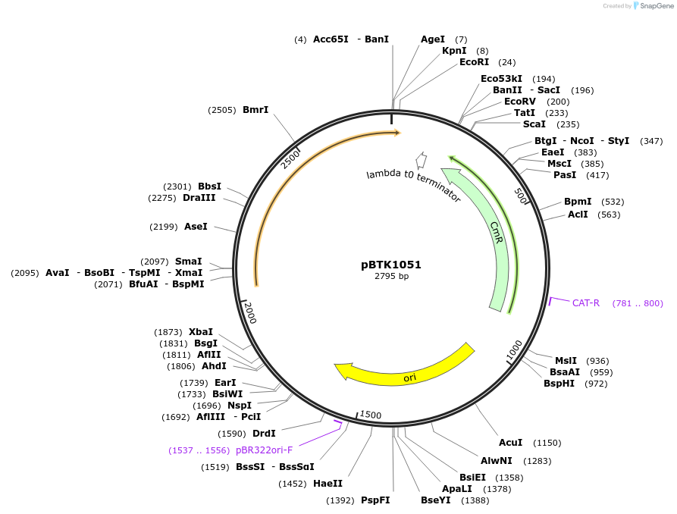
Homology Arm 2
[pBTK1051]
pBTK1051 is a BTK (Bee Microbiome Toolkit) Type 5 entry plasmid designed for Golden Gate assembly, containing a downstream homology arm for targeted recombination into the Snodgrassella alvi wkB2 genome between the SALWKB2_RS11215 and SALWKB2_RS11220 intergenic region. It uses pBTK1001 as the backbone, carries chloramphenicol resistance, and replicates as a high-copy plasmid in E. coli DH5α. The inserted homology arm is approximately 974 bp in size. BsmBI recognition sites are utilized for cloning and are destroyed during the assembly process. pBTK1051 serves as an essential part vector for final plasmid construction in genome engineering projects.

Slide 44
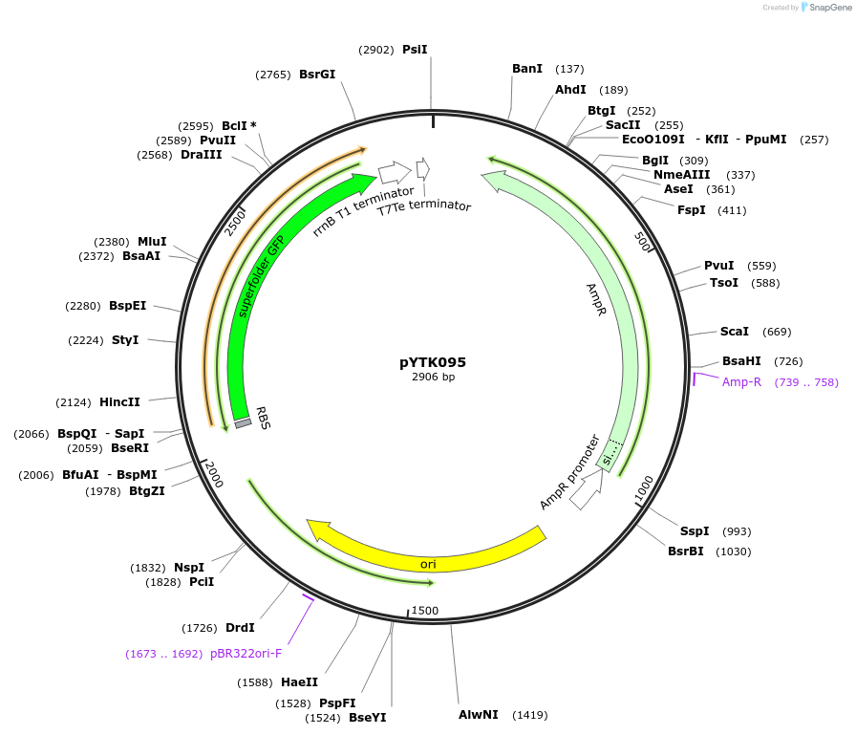
Vector Building - Backbone
Final backbone

Slide 45
Backbone
[pYTK095]
pYTK095 is a modular bacterial expression vector designed for Golden Gate Assembly, featuring Ampicillin resistance and a ColE1 origin. It enables seamless multi-part DNA assembly but requires integration into a broad-host-range vector for use in non-E. coli hosts.
However, in this project, we are not relying on plasmid replication in the host. Instead, we use homologous recombination to integrate the genetic cassette into the host genome. Therefore, the lack of a broad-host-range origin does not affect our strategy.

Slide 46
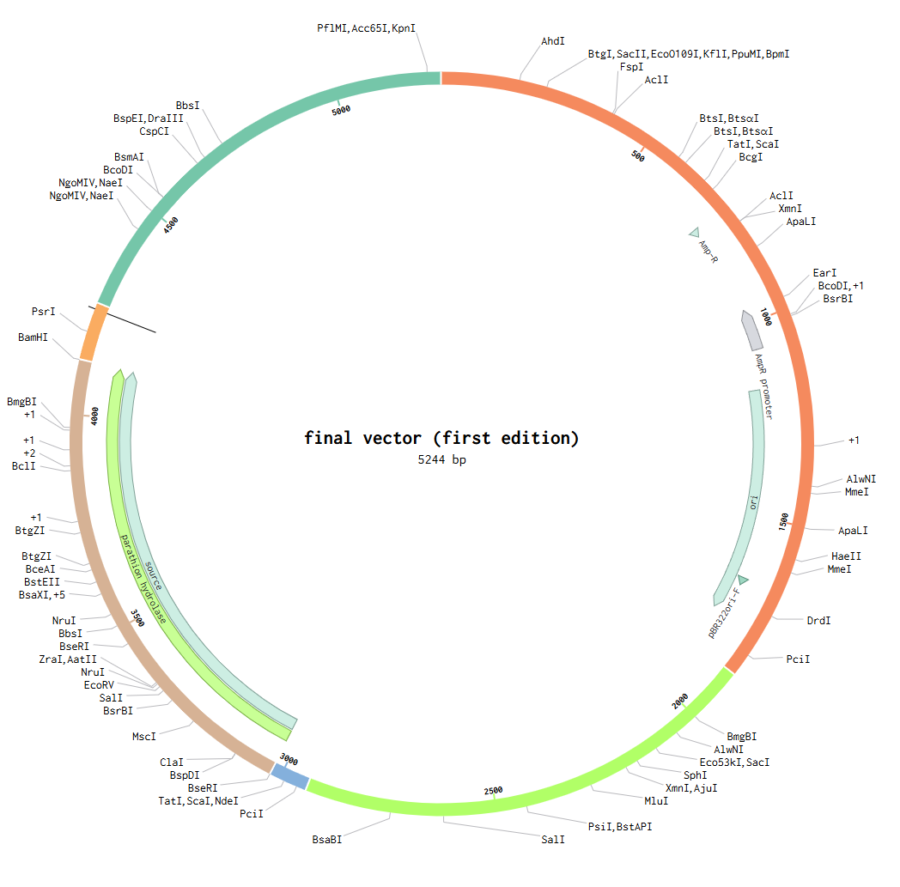
Prototype

Slide 47
Reference
Bird, J. E., Marles-Wright, J., & Giachino, A. (2022). A user’s guide to golden gate cloning methods and standards. ACS Synthetic Biology, 11(11), 3551–3563. https://doi.org/10.1021/acssynbio.2c00355
Lariviere PJ, Ashraf AHMZ, Navarro-Escalante L, Leonard SP, Miller LG, Moran NA, Barrick JE.2024.One-step genome engineering in bee gut bacterial symbionts. mBio15:e01392-24.https://doi.org/10.1128/mbio.01392-24
Leonard, S. P., Perutka, J., Powell, J. E., Geng, P., Richhart, D. D., Byrom, M., Kar, S., Davies, B. W., Ellington, A. D., Moran, N. A., & Barrick, J. E. (2018). Genetic Engineering of Bee Gut Microbiome Bacteria with a Toolkit for Modular Assembly of Broad-Host-Range Plasmids. ACS Synthetic Biology, 7(5), 1279–1290. https://doi.org/10.1021/acssynbio.7b00399
Lariviere, P. J., Leonard, S. P., Horak, R. D., Powell, J. E., & Barrick, J. E. (2022). Honey bee functional genomics using symbiont-mediated RNAi. bioRxiv (Cold Spring Harbor Laboratory). https://doi.org/10.1101/2022.04.22.489157

